Slide 1

Jiya Pharmachem
Speciality Chemicals & laboratories Chemicals

Slide 2


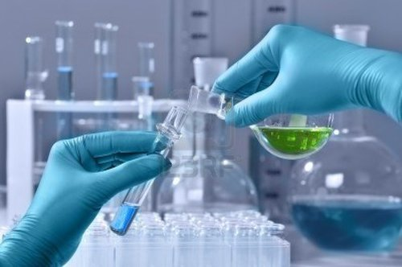
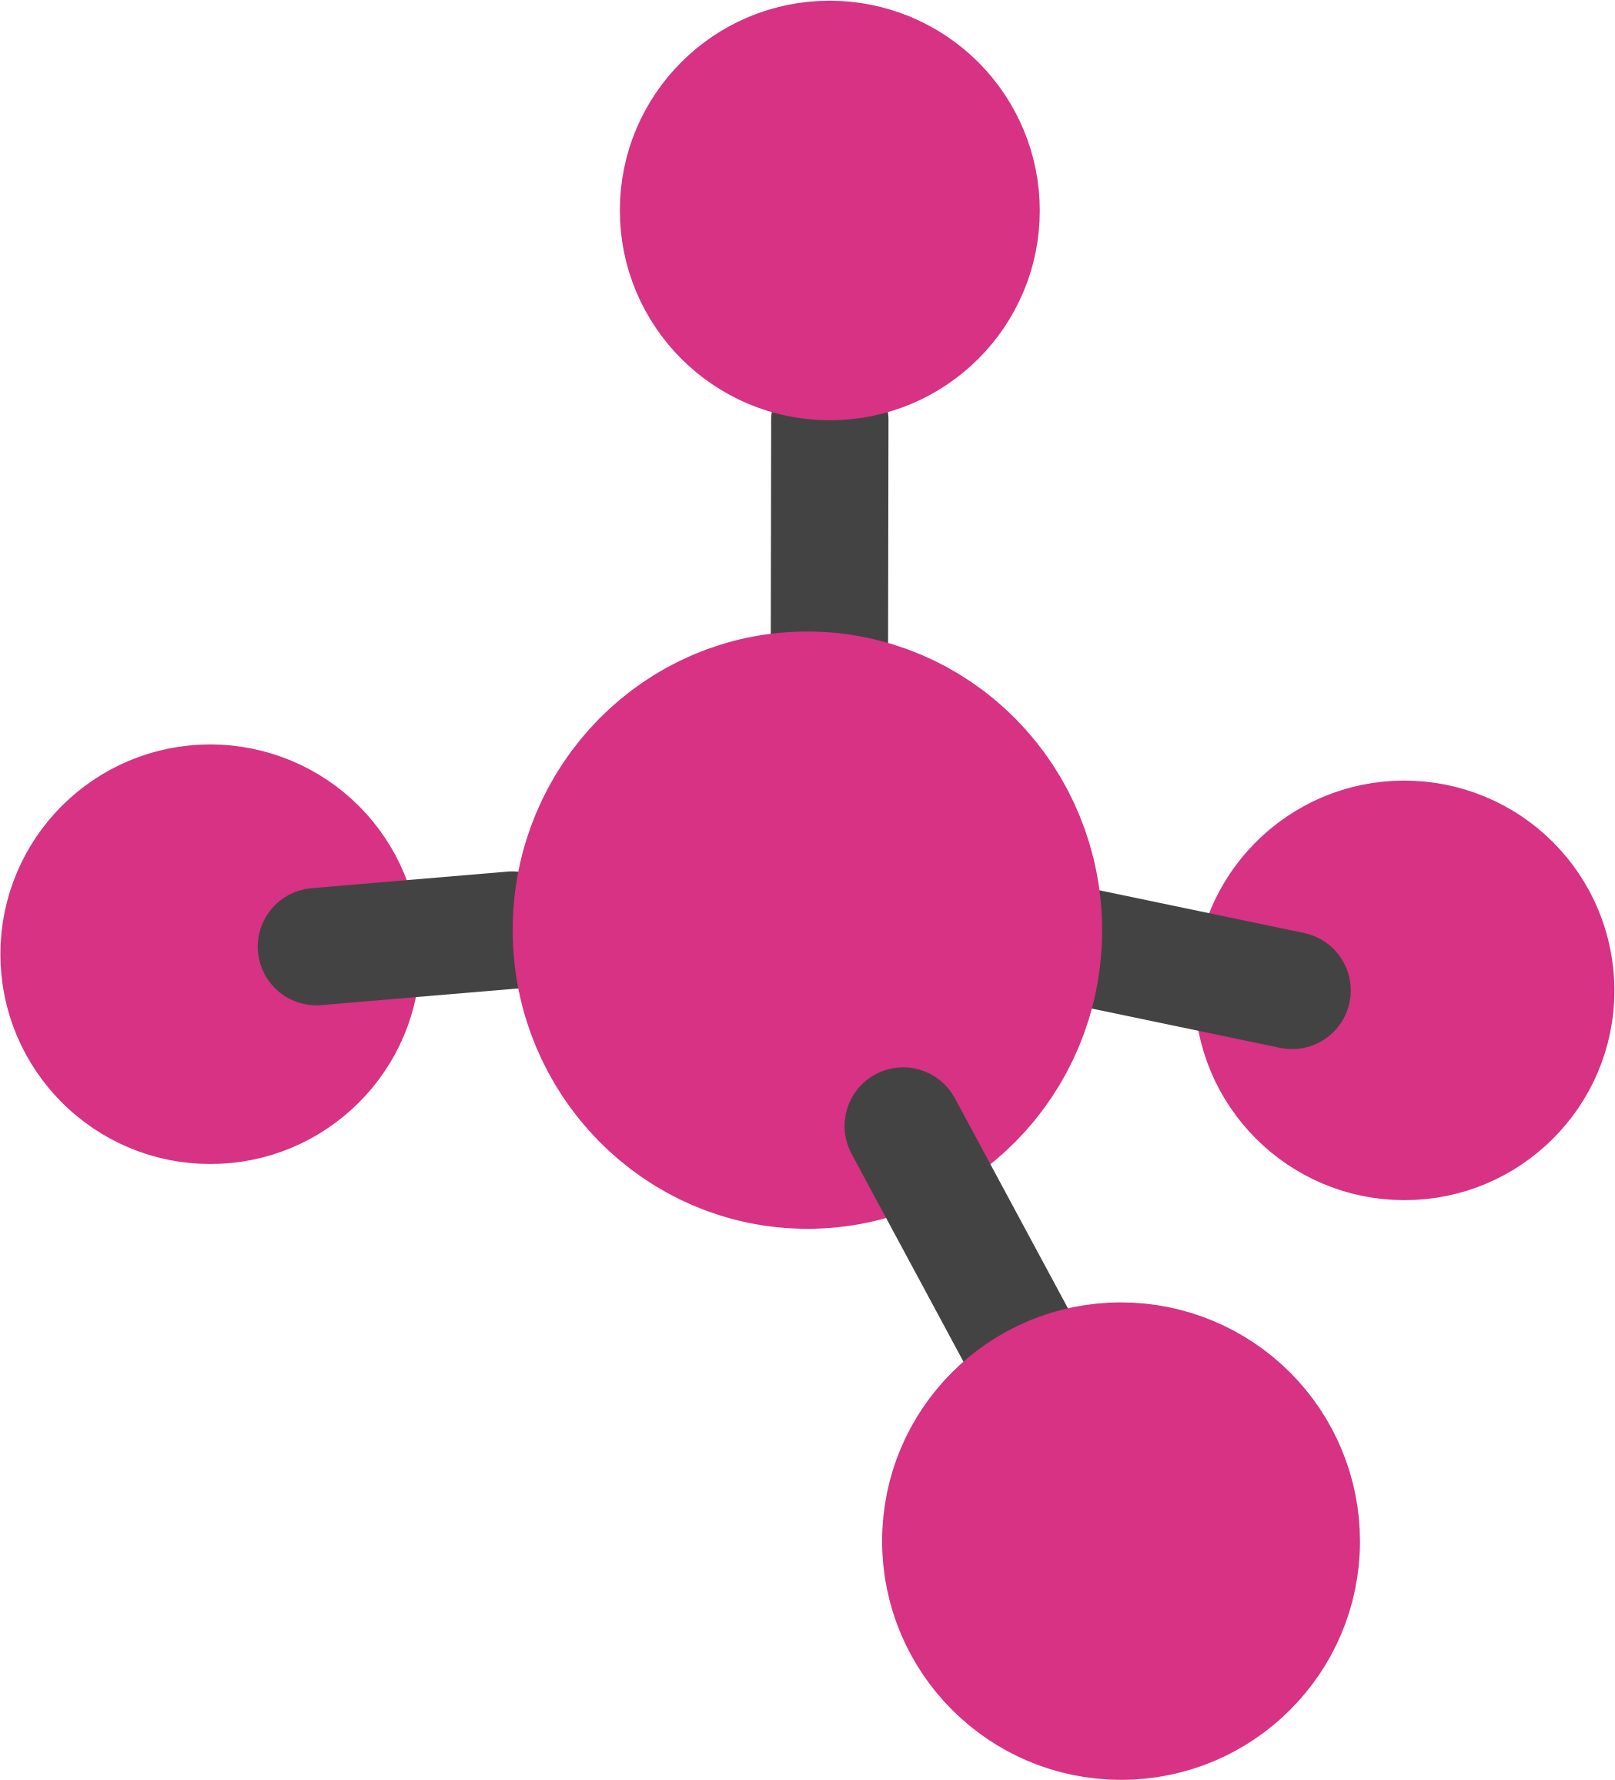
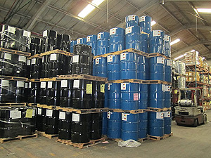
Jiya Pharmachem
We are suppliers and dealers in
Specialty Chemicals
Laboratory Chemical
New Molecule
Surplus chemical

Slide 3

Jiya Pharmachem
VISSION
Our vision is to be viewed as the best specialty chemical company in the world.
MISSION
We satisfy our customers by delivering results through quality chemical products and services. Our desire to grow drives our passion to win in the marketplace. With a unified, low-cost operating structure, we’ll remain competitive across every business and in every geographic region.

Slide 4
Jiya Pharmachem
Customer Satisfaction
A staunch believer of "Customer First, Reputation First", jiya pharmachem prides itself in being a customer oriented organization.
Our Principles
Jiya pharmachem believes that ethics are the driving force in any successful business. Also we strive to give back to the environment and society to ensure a sustainable future.
Our People
The people at jiya pharmachem are self driven to innovate, achieve excellence and set new global benchmarks.

Slide 5
Jiya Pharmachem
OUR INDUSTRIES INCLUDES
Chemicals industries
Pharmaceutical industries
Organic and inorganic industries.
Agrochemical industries
Petrochemical industries
Oleo chemical industries
Food processing industries.

Slide 6
Jiya Pharmachem
JIYA PHARMACHEM HAVE BEEN INVOLVED as an import and distribution company by providing range of specialty chemicals to various industries all over India AND INTERNATIONAL TOO.
We offer products to Coatings, Printing Inks, Construction Chemicals, Adhesives, Paper, Plastics industries etc. and have been one of the prominent distribution house
We offer our customers innovative solutions, technical support and expertise to enhance existing products or create solutions through new applications.
Our commitment to service excellence with team of dedicated professionals allow us to build a reputation to quality and reliability
Thanks to our industry expertise and extensive market knowledge we respond to changing market dynamics and emerging industry trends

Slide 7
Jiya Pharmachem
Acetic Acid | Acetone | Methanol | Toluene | N-Butanol | IPA | MDC
EDC | Phenol | MIBK | MEK | Butyl Acetate | Butyl Cellusolve | Butyl Carbitol
M-xylene | O-xylene | Cyclohexane | Cyclohexanone | Caustic Soda Lye | Caustic Potash Lye | Glycerine
Caustic Soda Flakes | Caustic Potash Flakes | THF | Soda Ash | Epichlorohydrin | DMF | Sodium Nitrite
Sodium Nitrate | Ethyl Acetate | Melamine | Maleic Anhydride | Pthalic Anhydride | Di Acetone Alcohol | Benzene
Nitro benzene | Acetonitrile | Formic Acid | Formaldehyde | Para formaldehyde | DIPE | Hydrogen Peroxide
Hydrazine Hydrate | DCDA | ONT | PNT | Soda Bi Carb | Hydrochloric Acid | Sodium Hypochlorite.

Slide 8
Jiya Pharmachem
Speciality chemicals (also called specialties or effect chemicals) are particular chemical products which provide a wide variety of effects on which many other industry sectors rely.
Laboratory Chemicals strives to provide new and unique laboratory reagents to scientists in all fields of study
When stock of material is no longer required for the job, it is called as surplus material.
A molecule is an electrically neutral group of two or more atoms held together by chemical bonds.

Slide 9
Jiya Pharmachem
We at jiya Pharmachem also takes order regarding job work.
if you need to carry out reaction for a particular product let us know, we will provide you the space and the requirement that you needed.
We also help you in manufacturing of equipment, like wise just give us the specification and the details of the equipment you required, we help you to get the best equipment with good life sustain quality.
At Jiya Pharmachem we Provide you Chemicals From Small Molecule To Multi tons.
We can support you from your R&D level to commercial scale
Or else
If you have extra capacity to carry manufacturing let us know, we will help you to make the efficient and optimize use of it.
We At jiya Pharmachem helps you to build from technical as well from the economic point of view.

Slide 10



Jiya Pharmachem
You can contact us
At
25, Kappeesh Mall, 1st Floor, M.G.Road, Mulund(W), Mumbai-400080
Telephone- 022-25908061
Email Us At- jiyapharmachem1@gmail.com
amit11jiyapharmachem@gmail.com jiyapharmachem15@gmail.com

